Slide 1

Human Resources Clinical Operations Session

Slide 2
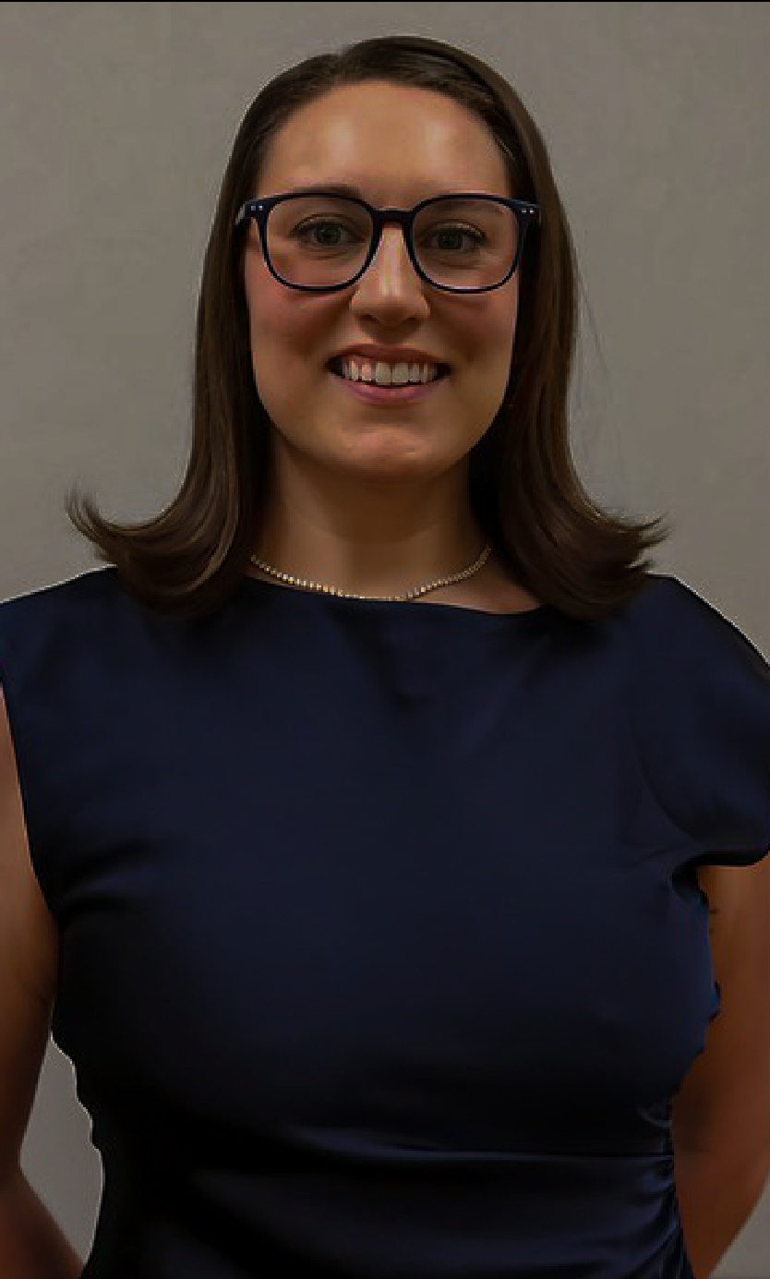
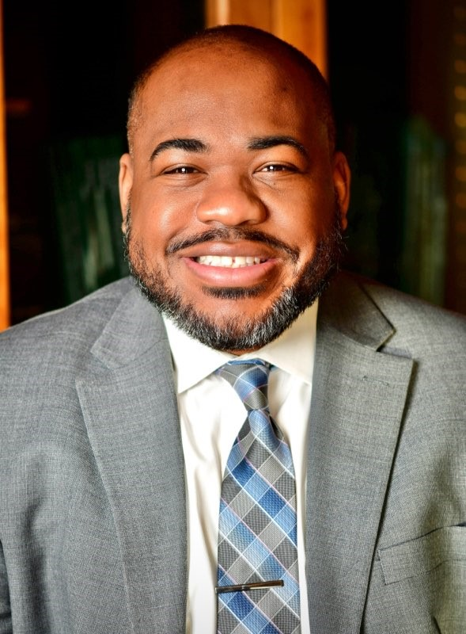

Presenters
Howard University Faculty Practice Plan
Emily Bigler, MSN-Ed, RN
Nurse Manager of Clinical Operations
Vincent Orange, Jr., MBA, MHSA
Chief Executive Officer
Dominique Stuckey, MSN, APRN
Senior Director of Clinical Development

Slide 3
Howard University Faculty Practice Plan
Ambulatory Care Center
28 Specialties
180 Providers
130,000 Annual Visits
Our Core Purpose
  The Faculty Practice Plan is committed to the advancement of healthcare and health equality, locally and globally by providing exemplary education, service and research that promotes patient-centered collaborative care and advocates for the elimination of health disparities.
  As an Entity
  Largest primarily African American Physician Group in the world, consists of 180+ Faculty that teach at Howard University College of Medicine and have privileges at Howard University Hospital
  28 specialties
  149 non-physician FTEs
  Locations: Howard University Towers, Medical Arts Building, Benning Road, Howard University Hospital
Notes:
Vincent Orange Jr. Slide

Slide 4


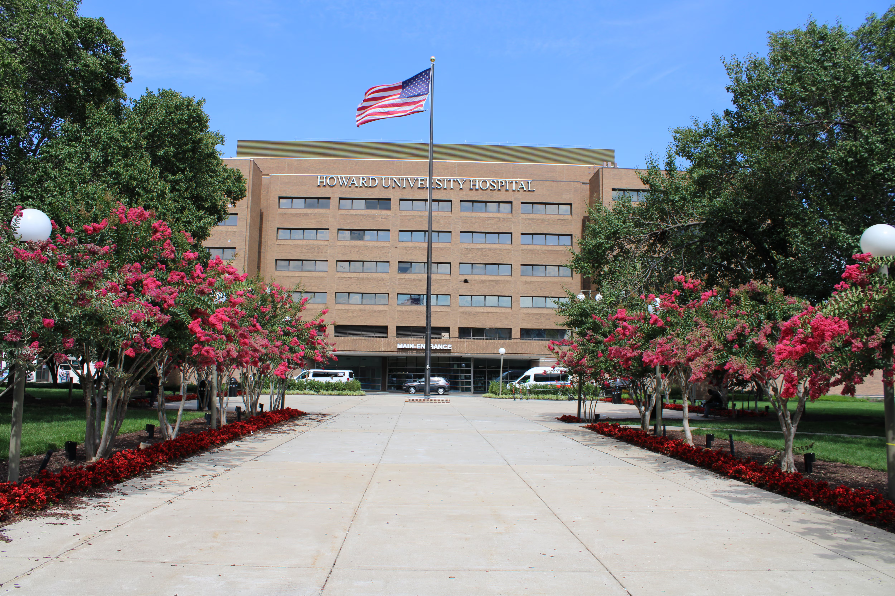


From Flatline
to Frontline:
Reviving Our Clinical Practice
Notes:
Vincent Orange Jr. Slide:
Adventist relationship

Slide 5



Our Timeline
Producing a culture of Clinical & Operational Excellence
(Schuettig & Sundmacher, 2022)
Strategic Clinical Operations Roles
(Addition of Nursing)
(Do et al., 2021; Sell-Gutowski, 2018)
September 2023
DCD Hired
NMCO Hired
October 2023
CPR Certification of MAs
January
2024
Fortis & HUFFP MA Pipeline Begins
January
2025
Graduation of DOES second YAP Cohort
June
2025
HUFPP begins journey with On-Site
Adventist Leadership Team
Cardiac Arrest in a clinic.
MA’s not BLS/CPR certified.
Notes:
Vincent Orange Jr. Slide:
Re-writing positions, advocating for roles, pipeline creation.
The formation of a new command structure and ambulatory care clinical ops roles facilitated a strong communication, oversight, and reinnervation of the operational infrastructure for the practice. Jan 2024, HUFPP onboarded the first MSN, RN to lead clinical development and close learning gaps across the ambulatory care center.
Emma & Dom: Retention & Pipeline w/ Fotis & Clinical Ladder. (Add roles & points in timeline. )
June 2024 all clinic facing staff were AHA CPR/AED certified.

Slide 6








Inherited Challenges
Inclement weather days reducing visits | (Wiskel et al., 2025)
No-Shows & Non-utilized appointments | (Cohen-Yatziv et al., 2019; Szwarc etal., 2019)
Old supplies, tools, and equipment | (Zamzam et al., 2021)
Poor optics & reputation | (Keith et al., 2024; Alsayah, 2022)
Existing Wages & Talent Pipeline
Disengaged staff & clinicians | (Dzau et al., 2018; Hall, 2023)
Quality, Safety & Infection opportunities
Notes:
Vincent Orange Jr. Slide:
? Staff Certifications (CMA, RMA): provide data on the increase since 2024 (supports engagement, and buy-in to the MA-CLP;
? Rapid Response
slide #5 please add pipeline of talent and wages are an inherited challenge
References = evidence happening throughout global systems

Slide 7


Leadership Framework
Top- Down
(Pearce & Van Knippenberg, 2024)
Transactional
Skill-Based
(Williams & Trulio, 2019).
Transformational
(Fletcher et al., 2019)
Notes:
Vincent Orange Jr. Slide:
::: your vision
This shows L to R less desirable leadership to more desirable. Though we were in top-down to start were using shared governance now which is bottom-up and statistically more effective.

Slide 8






Clinical Mission
To lead in the advancement of health care and health equity.
To provide exemplary education, service, and research that promotes patient-centered, high-quality, collaborative care and advocates for the elimination of health disparities.
Notes:
Dominique Slide:

Slide 9


Case Study
Code Blue: Resuscitating a Clinic
You arrive on the scene and complete your “Across the Room Assessment”:
The phones don’t work
Low staff morale, high absenteeism
High patient no-show rate
4. Uncertified, untrained staff
5. Supplies are expired, broken, missing
6. Everything from floor to ceiling is outdate, poor optics
Notes:
Dominique Stuckey Slide:
ABC’s: This is based on a true story …this is actual scene faced as the nurse leader upon arrival.

Slide 10















What do I do now?
Fire everyone?
Revert to your ABC’s…….
Run away?
Throw money at these problems?
Ignore & hope things get better?
YOU
Notes:
Dominique Stuckey Slide:

Slide 11

A
Airway
What is the airway of a clinic?
B
Breathing
How does the clinic breath?
C
Circulation
What is the flow and circulation of a clinic?
Notes:
Dominique Stuckey Slide:
Analogy: Just as CPR revives a person in crisis, cultural transformation can revive an organization.

Slide 12

A
Access & Optics (Bilezikian et al., 2023 ; Hester et al., 2021)
B
Buy-In built Resiliencies
(MGMA, 2025; Coplan et al., 2022)
C
Clinical
Operations (Larkin et al., 2025)
Notes:
Emma Bigler Slide:
When facing a shift in mission, mindset, or momentum, we must address the essential ABCs:
Access & Optics, Buy-in & Built Resiliencies, and Clinical Operations.
Why the Nurse Manager of Clinical Operation role……. What did nursing bring to operational excellence.

Slide 13



Access & Optics
Value Based Care
AI Cloud Based Phone System
Customer Service Coaching
Renovate Spaces
Marketing & Social Investment
Off-Site Locations
Notes:
Emma Bigler Slide:
"You can’t breathe life into a system if the airway is blocked.“
In organizations, access and optics are the airway for engagement and inclusion. Without clear pathways and visibility, the mission chokes before it breathes.
Are communication channels open and accessible?
Is our mission visible and understandable to everyone, internally and externally?
Are there barriers (hierarchies, biases, assumptions) blocking engagement?
Clear the "airway" of miscommunication or closed systems.
Improve transparency: Share updates, intentions, and decisions regularly.
Widen access: Ensure equity in who gets to contribute and lead.

Slide 14
Form Powerful Relationships
Remove Resistance
Convey the Needed Change
Embed resilient systems
Protect the Coalition
Consolidate Efforts
Maintain the Vision
Create a shared vision
Work the Mission
Buy-In
Display Dependability
Model Accountability
Celebrate & Enjoy
Be Authentic
Notes:
Emma Bigler Slide:
“Breathing sustains life….just as buy-in sustains culture.“
In organizations, buy-in is the breath that keeps cultural shifts alive. Resiliencies are the lungs that keep the system breathing during stress.
Culture dies without participation. Do people feel part of the change?
Resilience doesn’t just happen, it must be built and trained.
Buy-in isn’t compliance, it’s belief and investment.
Engage teams early in the "why" of change.
Build psychological safety , people are more resilient when they feel safe.
Offer tools for self-regulation, teamwork, and stress recovery.

Slide 15





Clinic Operations
Monthly Leadership + HR Meeting
Resilience of Operations
CMO
Quality Council
Workflows & Standardization
Staff
Re-education
Nursing Presence
Compliance & HR insights integrated into workflows & policy work.
Notes:
Emma Bigler Slide:
"Without clinical alignment, culture can’t reach the front lines.“
In organizations, clinical operations are how the mission (rules, values, standards) moves through the system to touch patients and providers alike.
Clinical operations are not separate from culture; they are where culture lives or dies.
If the systems don’t reflect the values, the culture won’t survive.
Circulation must be continuous and responsive.
Align workflows, policies, and systems with cultural values.
Measure not just performance but alignment.
Encourage cross-functional collaboration to keep systems healthy.
-Staff Re-education: Incorporated skills assessment with return demo for current staff during new MA orientation (one week; skills assessments and return demonstration): Began May 2024-current
-Multidiscip: Quality Meeting with CMO/Compliance/Nursing/CEO (safety events, incident reporting. Policies, SOP.s)
-5/20 Skills fair: 1st annual staff training and education

Slide 16



Human Resources Clinical Operations
JDs, Investment
Operational Excellence
Process by role delineation
Scope
MGMA Clinical Teams Model
Compensation Tiers
Organizational Governance
Pipelines
People
Process
Notes:
Dominique Slide:

Slide 17
Solutions
Socializing & Standardizing
Training & Standard Competencies
(McAteer & Moyer, 2022; Delgrippo & Porzig, 2024)
Policy & Procedures
(Moosavi et al., 2025)
Integrated Teams & Workflows
(Qureshi & Keller, 2023; Sell-Gutowski, 2018)
Shared Governance
(Hasselblad & Loan, 2022; Meyers & Costanzo, 2015)
Advancement & Appreciation
(Paulose et al., 2025; Hossli et al., 2018)
Notes:
Dominique Stuckey Slide:
It was so timely for our Clinical Ops Nurse Manager to provide observations from her perspective ….(chat time EB started)
Dominique: 5 ?? Connect to overall goal VOJ gave me
Multidisciplinary approach to our MA-CLP committee (executive sponsor, nursing leadership, clinical management)
Staff appreciation:

Slide 18


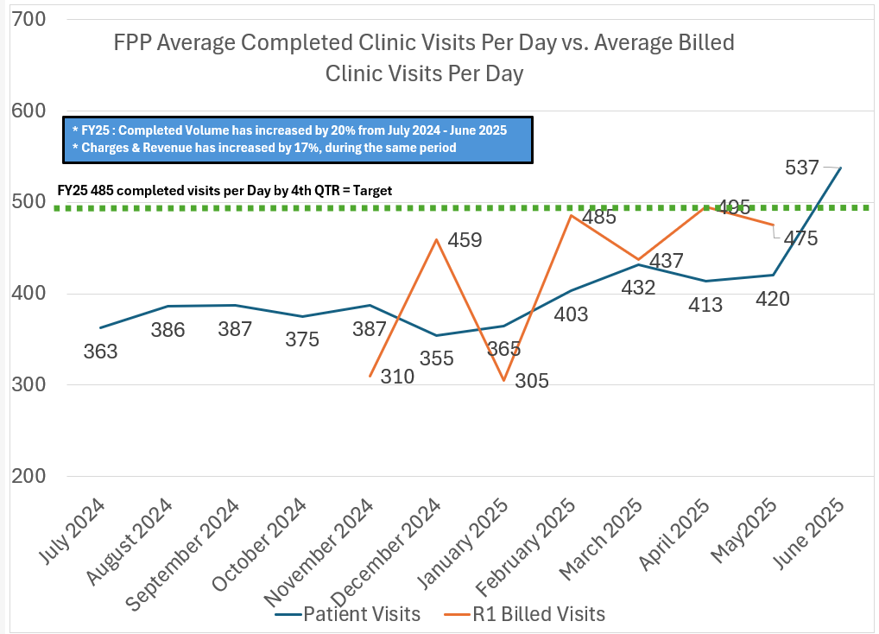
Current State
Notes:
VOJ Slide:

Slide 19


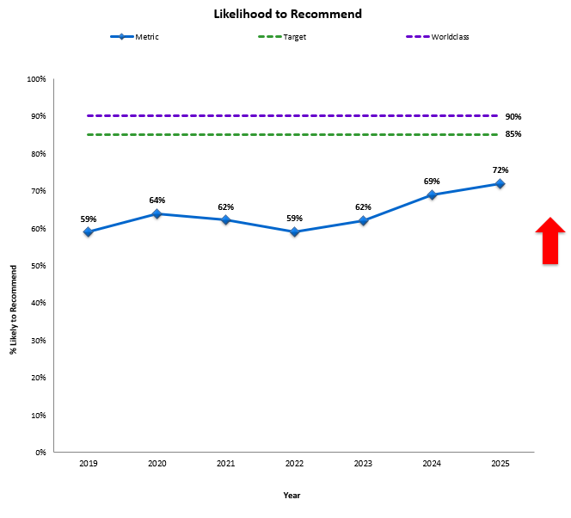
Patient Experience
Notes:
Vincent or Dom Slide:
I will also add slides about our patient experience scores
Customer service, service recovery

Slide 20

Key Takeaways
Align with goals, not active insufficiencies
Pipelines to Operational Resiliencies
Foundation laying can happen dynamically, in any workplace.
Buy-In is critical & Shared Governance works
Focus on Resilience of Process & People
Notes:
Vincent Orange Jr. Slide:
-Buy-in is critical to improving staff engagement and improving overall operations
-not all staff will align with the culture shift and that's okay. Our role is to lay the foundation according to the mission/values of our organization.

Slide 21


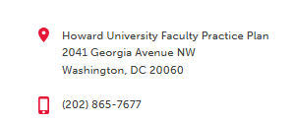
Howard CARES for you like family, because you are.
“Collaboration, Accountability, Respect, Excellence & Service”
Notes:
Vincent Orange Jr. Slide:

Slide 22

Notes:
Vincent Orange Jr. Slide:

Slide 23
References
Alsayah, A. (2022). Strategic alignment and its impact on creating an organization’s reputation and image. Problems and Perspectives in Management, 20(1), 501–513. https://doi.org/10.21511/ppm.20(1).2022.40
Bilezikian, J., Kimmel, R., & Thurston, T. (2024). Plastic and Reconstructive Surgery Resident Indigent Care Clinic Optimization by Improving “No-Show” Rates. Annals of Plastic Surgery, 93(3S), S110–S112. https://doi.org/10.1097/SAP.0000000000003996
Cohen-Yatziv, L., Cohen, M., Halevy, J., & Kaliner, E. (2019). No-shows in ambulatory clinics and non-utilized appointments for elective operations in selected surgical departments at a tertiary hospital in Israel. Israel Journal of Health Policy Research, 8(1), 64–64. https://doi.org/10.1186/s13584-019-0333-5
Coplan, B., Kelly, L., & Yang, H. (2022). Medical Assistant Psychological Safety Linked to Leader Inclusiveness in Ambulatory Care Settings. Journal of Allied Health, 51(1), 21–25.
Dzau, V., Kirch, D., & Nasca, T. (2018). To Care Is Human — Collectively Confronting the Clinician-Burnout Crisis. The New England Journal of Medicine, 378(4), 312–314. https://doi.org/10.1056/NEJMp1715127
Delgrippo, T., & Porzig, S. (2024). BRIDGING THE GAP: INTEGRATING UPSKILLED MEDICAL ASSISTANTS INTO THE AMBULATORY CLINIC SETTING. Oncology Nursing Forum, 51(2), 45C-46C.
Do, T., Luon, S., Boothe, K., Stutsky, M., & Renauer, M. (2021). Advancing ambulatory pharmacy practice through a crisis: Objectives and strategies used in an ambulatory care action team’s response to the COVID-19 pandemic. American Journal of Health-System Pharmacy, 78(8), 720–725. https://doi.org/10.1093/ajhp/zxab063
Fletcher, K., Friedman, A., & Piedimonte, G. (2019). Transformational and Transactional Leadership in Healthcare Seen Through the Lens of Pediatrics. The Journal of Pediatrics, 204, 7-9.e1. https://doi.org/10.1016/j.jpeds.2018.10.007
Hall, T. (2023). What Matters Most to Medical Assistant Job Burnout and Job Satisfaction? A Mixed Methods Study. Annals of Family Medicine, 21(Suppl 1). https://doi.org/10.1370/afm.21.s1.4013
Hasselblad, M., & Loan, L. (2022). Implementing Shared Governance to Improve Ambulatory Care Nurse Perceptions of Practice Autonomy. AAACN Viewpoint, 44(3), 4–8.
Hester, T., Thomas, R., Cederna, J., Peterson, A., Brown, J., Johnson, T., & Cha, K. (2021). Increasing Access to Specialized Dermatology Care: A Retrospective Study Investigating Clinical Operation and Impact of a University-Affiliated Free Clinic. Dermatology and Therapy, 11(1), 105–115. https://doi.org/10.1007/s13555-020-00462-z
Hossli, S. M., Start, R., & Murphy, M. P. (2018). Implementation and Evaluation of an Ambulatory Care Nurse Clinical Advancement System. Nursing Economic, 36(3), 149–155.
Keith, D., Taylor, L., Paine, J., Weisbach, R., & Dowidowicz, A. (2024). When Funders Aren’t Customers: Reputation Management and Capability Underinvestment in Multiaudience Organizations. Organization Science (Providence, R.I.), 35(2), 387–404. https://doi.org/10.1287/orsc.2022.1579
Larkin, S., Harness, E., Arora, K., Qasba, N., Chesnokova, A., Banks, E., George, K., & Vinekar, K. (2025). Payer-Based Segregation in Obstetrics and Gynecology Ambulatory Care: Implications for Quality, Safety, and Equity. Obstetrics and Gynecology (New York. 1953), 145(5), 469–474. https://doi.org/10.1097/AOG.0000000000005883

Slide 24
References
McAteer, M., & Moyer, A. (2022). Standard Competencies in Ambulatory Care: An Urgent Need. The Journal of Continuing Education in Nursing, 53(2), 59–62. https://doi.org/10.3928/00220124-20220104-05
Meyers, M., & Costanzo, C. (2015). Shared Governance in a Clinic System. Nursing Administration Quarterly, 39(1), 51–57. https://doi.org/10.1097/NAQ.0000000000000068
Moosavi, A., Ozturk, O., & Patrick, J. (2025). Dynamic Distributed Ambulatory Care Scheduling. Production and Operations Management. https://doi.org/10.1177/10591478251331143
Paulose, J., Saadiya Ahmad S A Alhebail, Haya Ahmed Abdul-Fattah Samara, Augustine, S., Nabi, S., & Mohammed Ahmed Al-Jalham, K. (2025). 46 Cultivating a safety symphony through good catch and great save awards in ambulatory care center. BMJ Open Quality, 14(Suppl 2), A59–A60. https://doi.org/10.1136/bmjoq-2025-IHI.46
Powers, S., & Bacon, C. (2016). Interdisciplinary Shared Governance in Ambulatory Care: One Health System’s Journey. Nursing Administration Quarterly, 40(3), 262–268. https://doi.org/10.1097/NAQ.0000000000000170
Qureshi, N., & Keller, M. (2023). Identifying Implementation Factors for the Development, Operation, and Sustainment of Ambulatory Care Pharmacy Programs: a Qualitative Study. Journal of General Internal Medicine : JGIM, 38(15), 3381–3388. https://doi.org/10.1007/s11606-023-08375-1
Schuettig, W., & Sundmacher, L. (2022). The impact of ambulatory care spending, continuity and processes of care on ambulatory care sensitive hospitalizations. The European Journal of Health Economics, 23(8), 1329–1340. https://doi.org/10.1007/s10198-022-01428-y
Sell-Gutowski, J. (2018). Authentic Leadership in Ambulatory Care Nursing: A Fit for the Future (Part 2). AAACN Viewpoint, 40(6), 1–10.
Sell-Gutowski, J. (2018). Authentic Leadership in Ambulatory Care Nursing: A Fit for the Future. AAACN Viewpoint, 40(4), 17–18.
Szwarc, E., Bocewicz, G., Banaszak, Z., & Wikarek, J. (2019). Competence allocation planning robust to unexpected staff absenteeism. Eksploatacja i Niezawodność, 21(3), 440–450. https://doi.org/10.17531/ein.2019.3.10
Williams, C., & Trulio, L. (2019). The Role of the Medical Group Management Association in Helping Practice Managers: An Interview with Dawn Wilno. MD Advisor, 12(2), 24.
Wiskel, T., Matthews-Trigg, N., Stevens, K., Miles, T., Dresser, C., & Bernstein, A. (2025). Frontline Clinic Administrator Perspectives on Extreme Weather Events, Clinic Operations, and Climate Resilience. The Journal of Ambulatory Care Management, 48(2), 73–83. https://doi.org/10.1097/JAC.0000000000000519
Zamzam, A., Abdul Wahab, A., Azizan, M., Satapathy, S., Lai, K., & Hasikin, K. (2021). A Systematic Review of Medical Equipment Reliability Assessment in Improving the Quality of Healthcare Services. Frontiers in Public Health, 9, 753951–753951. https://doi.org/10.3389/fpubh.2021.753951

