Slide 1



Prince George's County Board of Health: Expanding Primary Care Access
Howard University Faculty Practice Plan
Vincent Orange Jr., MBA, MHA - Chief Executive Officer
Leslie Jones, MD – Chief Medical Officer

Slide 2

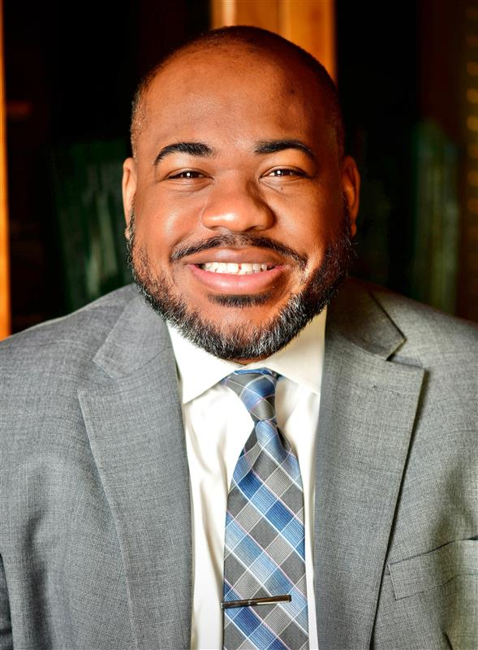
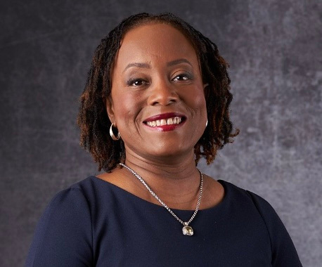


Howard Faculty Practice Plan
Executive Leadership Team
BS, Biology Morehouse College
Master Health Administration George Washington University
Master Business Administration Georgetown University
20 + Years Leadership Experience
Rutgers/RWJBH
University of Virginia
John Hopkins Health System
GW Medical Faculty Associates
MedStar Health, Inc.
Unity Health Care, Inc.
BA, University of Virginia
Doctor of Medicine, Howard University
Residency in Ophthalmology, Howard University Hospital
Fellowship in Glaucoma, Wills Eye Hospital
Clinical Associate Professor & Chair, Department of Ophthalmology
Past recipient, American Glaucoma Society Clinician-Scientist Award
Research in glaucoma therapies, genetic epidemiology, and simulation-based training
25+ years of clinical and leadership experience at Howard University
Vincent Orange Jr., MHA, MBA
Chief Executive Officer
Leslie Jones M.D.
Chief Medical Officer

Slide 3

Agenda
01
02
03
Prince George’s
County - Overview
Current Physician Shortage
Impact on Social & Welfare Needs
04
05
Faculty Practice
Plan - Overview
Faculty Practice Plan Clinical Alignment – Prince George's County

Slide 4
Overview
The Problem That Must Be Solved : ​
​ Prince George's County Board of Health
"Improving access to primary care is one of the Board of Health’s top priorities and we seek to get a better understanding as to what are the barriers in increasing access to primary care and what can be done to address the existing deficit."​
Howard Faculty Practice Plan's response is the following : ​
Prince George's County must partner with a healthcare entity that intimately understands the care and socioeconomic concerns for its residents. ​
The proposed partner must have a business model, that is committed to hiring primary care physicians that will practice in the County, as well as bring the County to the national physician per capita standards.
The proposed partner must be committed to the community and have a lasting presence.​
The proposed partner must be prepared to invest in service lines that mirror the clinical needs of the county, in addition to primary care.
The proposed partner must be committed to employment pipelines in the county, that provide physician support and long-term career growth for county residents.
The proposed partner must provide culturally competent care. ​
​

Slide 5


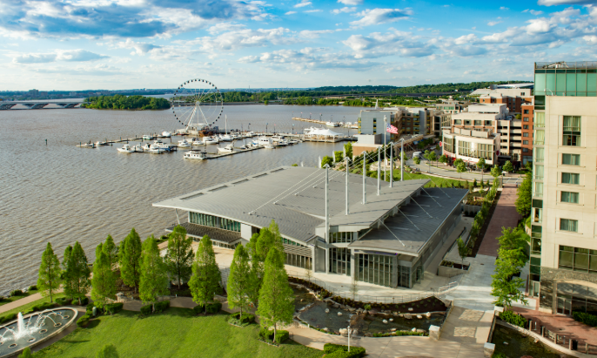
Prince George’s County
Health & Demographic Needs Assessment

Slide 6

Prince George's County – Population Analysis
Based on the Prince George's County Community Health Assessment, we recognize county residents face the following health outcomes – Howard University is here to care for residents:
Health Outcomes
Howard University
Obesity (~50% of Adults)
Diabetes (~12% prevalence)
Maternal Health Disparities
Cancer
Behavioral Health and Substance Use
Bariatric Medicine/Surgery
Diabetes Treatment Center
OBGYN + Fibroids Robotic Surg. Specialist
Oncology + Breast, Prostate Specialist
Psychiatry + Behavioral Health
Notes:
Source for all these statistics: https://www.princegeorgescountymd.gov/sites/default/files/media-document/Prince%20George%27s%20County%20Healthcare%20and%20Social%20Needs%20Assessment%20%2B%20Investment%20Strategy%20Final%20Report-compressed.pdf

Slide 7
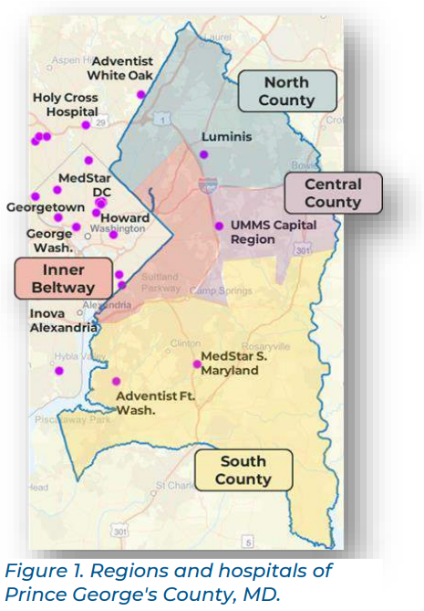
Prince George's County – Healthcare Needs Assessment
  Deficit of ~1,050 physicians, more than half attributed to primary care
  Deficit of ~475 hospital beds, with 78% fewer beds per 1,000 residents than the U.S. average
  ~42% of care is sought outside the County, signaling lack of local capacity
    Indirectly costing economic development and job creation
  Nearly half of adults (~265,000 residents) live in medically underserved areas
Source: Prince George's County – Huron Report
Notes:
Source for all these statistics: https://www.princegeorgescountymd.gov/sites/default/files/media-document/Prince%20George%27s%20County%20Healthcare%20and%20Social%20Needs%20Assessment%20%2B%20Investment%20Strategy%20Final%20Report-compressed.pdf

Slide 8
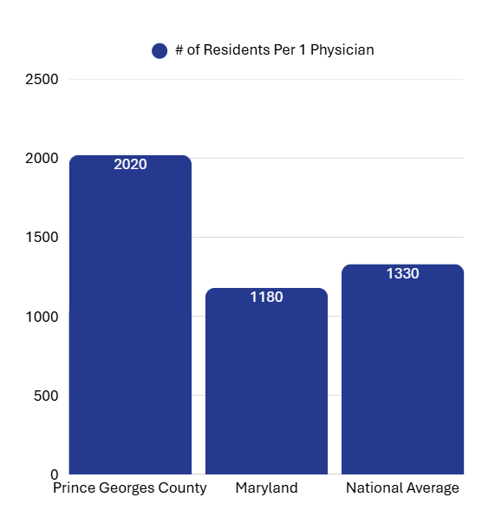
Prince George's County – Physician Shortage Per Capita
Prince George’s County:
1 physician per 2,020 residents
Maryland (average):
1 physician per 1,180 residents
United States (average):
1 physician per ~1,330 residents
Source: Prince George's – County Health Rankings
Notes:
Source:
https://pgccouncil.us/DocumentCenter/View/12491/Presentation---Regional-Primary-Care-Coalition-Prince-Georges-County-Community-Health-Center-Collaborative-February-26-2025?
https://www.countyhealthrankings.org/health-data/maryland/prince-georges?year=2025

Slide 9
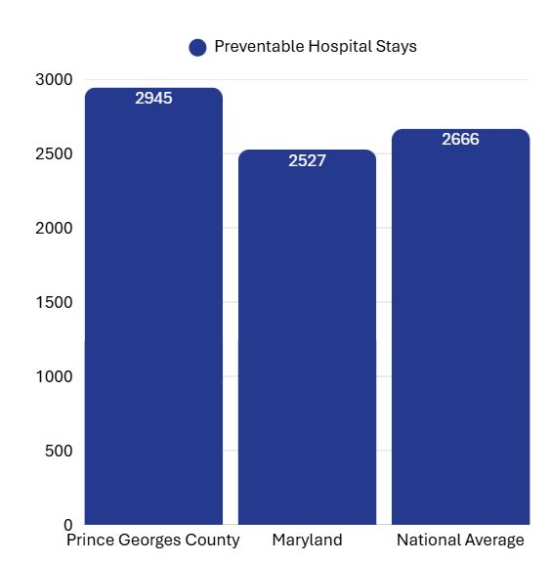
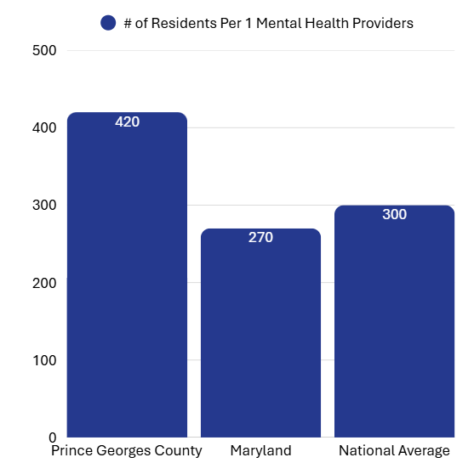
Prince George's County – Primary Care Gap Impact on Mental Health & Hospital Stays
Source: Prince George's – County Health Rankings
Notes:
Source:
https://www.princegeorgescountymd.gov/sites/default/files/media-document/Prince%20George%27s%20County%20Healthcare%20and%20Social%20Needs%20Assessment%20%2B%20Investment%20Strategy%20Final%20Report-compressed.pdf

Slide 10
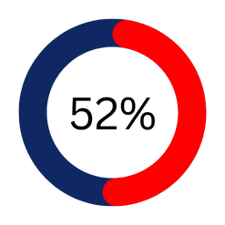
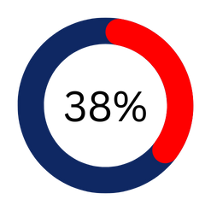
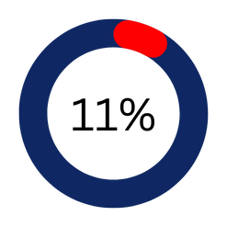
Social Needs Intensify Health Challenges
Food Insecurity:
Housing Quality Concerns:
Transportation Insecurity:
52% of adults in the Inner Beltway (~83,000 residents)
38% of adults (~60,000)
11% of adults (~17,000)
RELATION
Higher social risk is directly tied to avoidable ED use and escalating cost of care
1
Uninsured: 11% overall vs. 7% state avg.
2
Children in poverty: 14% overall vs. 11% state avg. (~29,000 kids)
Notes:
https://www.princegeorgescountymd.gov/sites/default/files/media-document/Prince%20George%27s%20County%20Healthcare%20and%20Social%20Needs%20Assessment%20%2B%20Investment%20Strategy%20Final%20Report-compressed.pdf
https://www.countyhealthrankings.org/health-data/maryland/prince-georges?year=2025

Slide 11
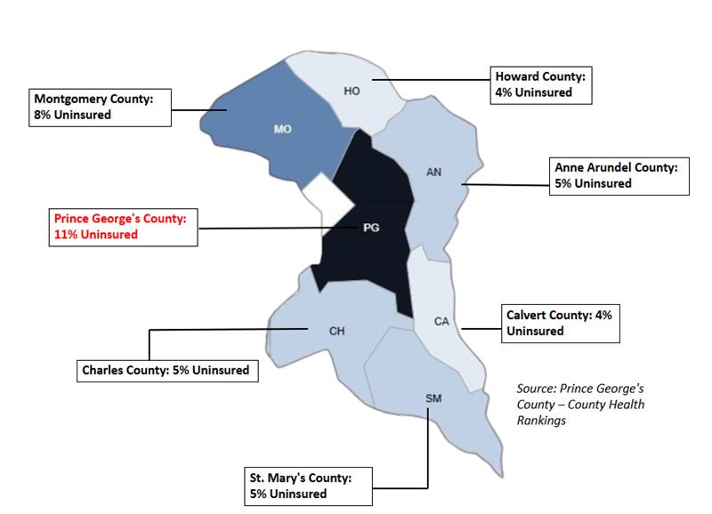
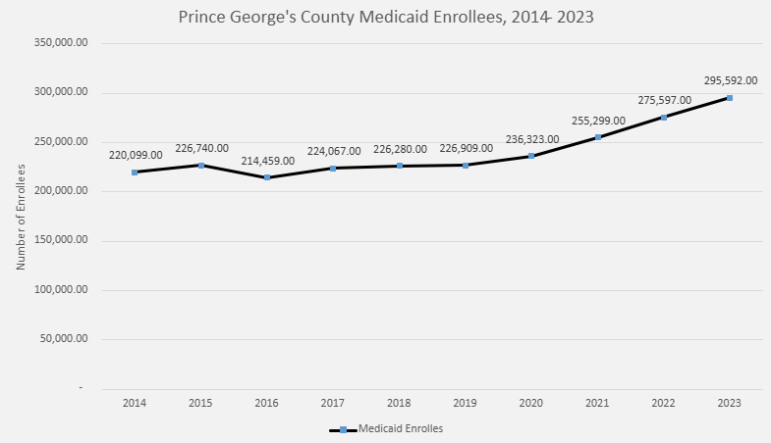
Prince George's County Medicaid Enrollees
In FY 2023, combined state and federal Medicaid expenditures averaged $9,109 per enrollee, a 50-year high (Pew/Governing, 2023).
Although Medicaid has lower payment rates, Medicaid patients are more likely to face access barriers: a meta-analysis showed many physicians are less likely to accept new Medicaid patients (e.g. ~45 % of primary care providers willing to accept Medicaid vs ~94 % for private insurance)
Higher Costs
Lower Access
Notes:
Source:
https://www.princegeorgescountymd.gov/sites/default/files/media-document/2025%20Community%20Health%20Assessment.pdf
https://pmc.ncbi.nlm.nih.gov/articles/PMC6452575

Slide 12
Emergency Department Wait Times & Impact
Over 2 hours before evaluation, the highest in the state
37% higher than Maryland average, linked to lack of primary care access
42% of all care delivered outside the County - including many emergency visits
Inner Beltway communities have no local hospital, forcing reliance on distant EDs for urgent needs
ER is being used as a safety net for primary and preventive care, driving costs and worsening outcomes
Average ER Wait Time
Avoidable
ED Visits
Care Location
Inner Beltway Healthcare Access
ER Utilization
When patients receive care within a consistent physician group they are ~10 % less likely to go to the emergency department within 7 days (Annals of Family Medicine, 2017).
Physician groups that centralize care continuity and coordination help shift patients from emergency use toward outpatient settings, reducing avoidable ED visits (RWJF Urgent Matters Report, 2023).
Physician groups are positioned to provide coordinated care, triage systems, follow-up, and access channels that divert low-acuity demand away from the ED (CMS Innovation Center, 2019).
Physician shortage leaves residents with no choice but to rely on emergency departments for basic and preventive care, driving long waits, higher costs, and worse outcomes.
Notes:
Source: https://www.princegeorgescountymd.gov/sites/default/files/media-document/Prince%20George%27s%20County%20Healthcare%20and%20Social%20Needs%20Assessment%20%2B%20Investment%20Strategy%20Final%20Report-compressed.pdf
Article with wala umi walking around hospital – see if we need to add anything from this to slide

Slide 13

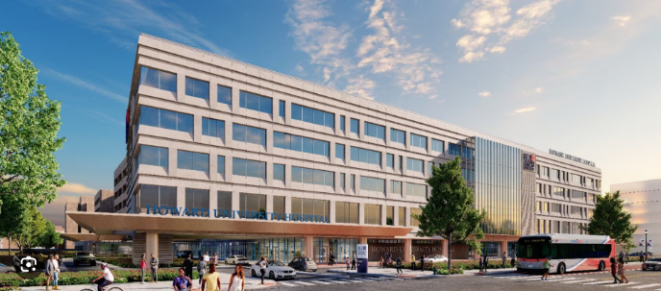
Howard University
Faculty Practice Plan (FPP)

Slide 14
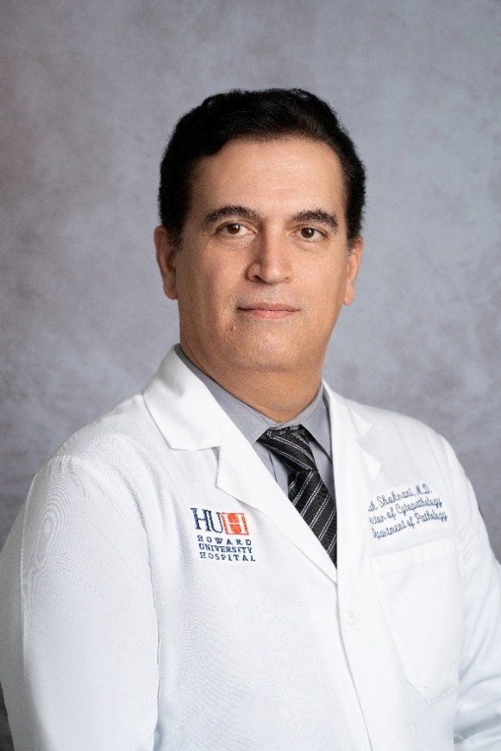

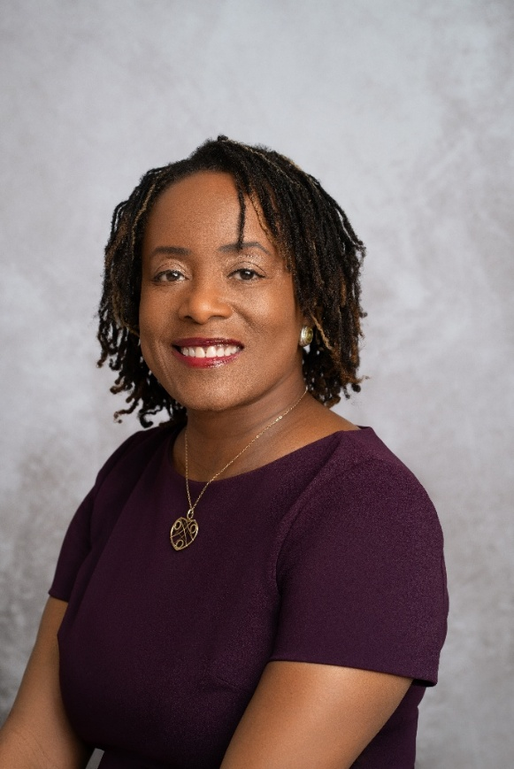


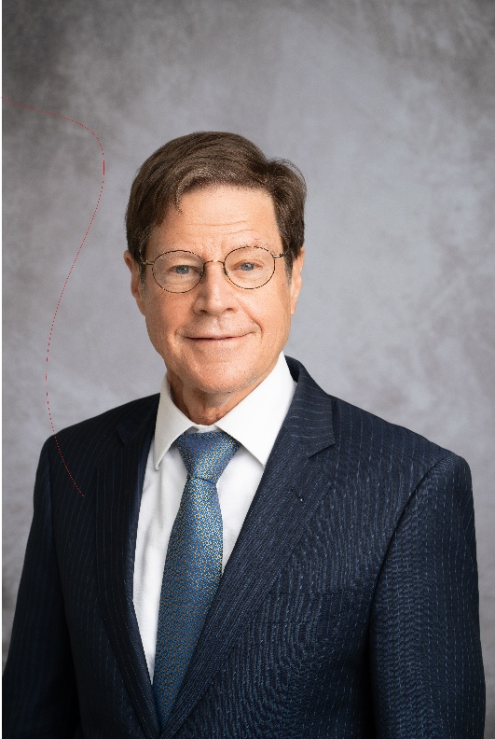
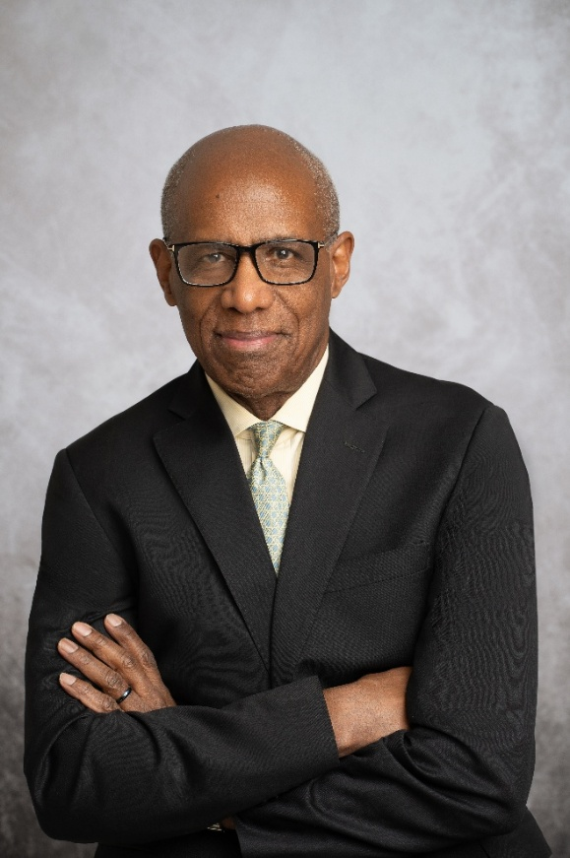
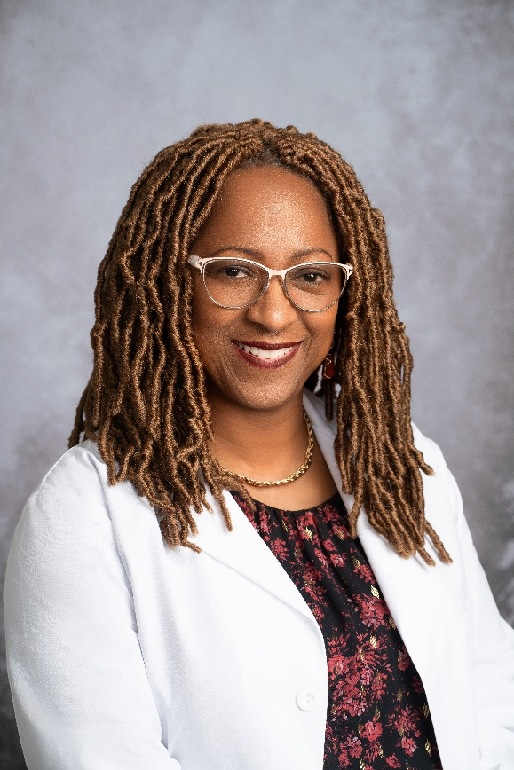

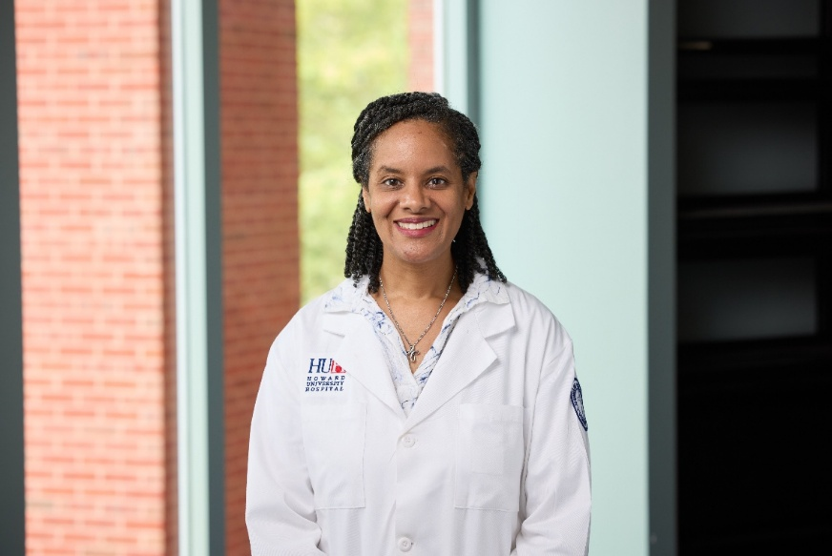
FPP Department Chairs

Slide 15
Howard University Faculty Practice Plan
Our Mission:
The Faculty Practice Plan is committed to the advancement of healthcare and health equality, locally and globally by providing exemplary education, service and research that promotes patient-centered collaborative care and advocates for the elimination of health disparities.
Specialties:
Obstetrics & Gynecology​
Pediatrics​
Community & Family Medicine​
Dermatology​
Ophthalmology​
Psychiatry​
Neurology​
Orthopedics & Rehab​
Medicine Specialties:
Allergy & Immunology​​
Gastroenterology​​
Endocrinology​​
Cardiology​​
Geriatrics​​
Internal Medicine​​
Pulmonary Disease​​
Infectious Disease​​
Hematology & Oncology​​
Rheumatology​
Surgery Specialties
Neuro Surgery​​
Colon Rectal Surgery​​
Otolaryngology​​
Plastic Surgery​​
Podiatry​​
Surgical Oncology​​
Bariatric Surgery​​
Trauma & Critical​​
Urology​​
Vascular Surgery​​
​
Largest primarily African American Physician Group in the world, consists of 180+ Faculty that teach at Howard University College of Medicine and have privileges at Howard University Hospital
28+ Specialties
180+ Providers

Slide 16
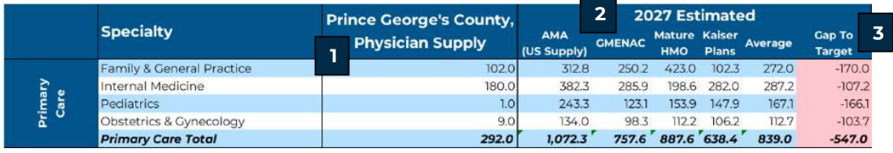

Huron Report: Howard U FPP Gap Analysis
As identified by the Huron Report, Prince George's County currently faces a gap of 547 physicians.
FPP Primary Care: Specialties | Additional Patient Capacity as of October 6th
Family & General Practice | 3,280
Internal Medicine | 2,584
Pediatrics | 2,317
Obstetrics & Gynecology | 1,819
Grand Total Unique New Patients | 10,000
Currently, ~40% of FPP Faculty Live in Prince George's County
The needs of Prince George's County are aligned with FPPs expansion plan: By 2030 the FPP will expand to 13% market share
FPP is committed to Hire 20 – 40 new faculty that fit Prince George's county Primary Care definition. The investment in faculty will help the county meet the national average for patient to physician ratio.
Right now, the FPP is equipped to see an additional 10,000 Prince George's County Residents
Notes:
https://www.nber.org/system/files/working_papers/w30767/w30767.pdf

Slide 17
Prince George's County – Primary Care Physician Ratio by Zip Code
Source: Prince George's County – Huron Report
Notes:
Source:
https://www.princegeorgescountymd.gov/sites/default/files/media-document/Prince%20George%27s%20County%20Healthcare%20and%20Social%20Needs%20Assessment%20%2B%20Investment%20Strategy%20Final%20Report-compressed.pdf

Slide 18




FPP - Innovative Models of Care Delivery
Diagnosis-Based Scheduling model ensures the highest acuity patients are treated first
Mobile clinic program capable of reaching medically underserved neighborhoods
Telehealth and digital health platforms expand access to hard-to-reach populations
Data-driven outreach identifies high-burden ZIP codes to optimize physician deployment

Slide 19
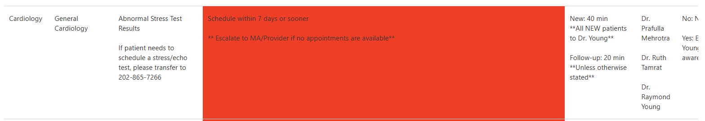
FPP: Diagnosis-Based Scheduling: FPP Schedule Advisor
Schedule Advisor:
FPP’s diagnosis-based scheduling tool that triages patients by condition and acuity. By matching appointment length and urgency to diagnosis, it reduces wait times, improves access, and ensures high-risk patients receive timely care (Medical Care, 2018).
Acuity-based scheduling reduced median wait times for urgent patients by 34% compared to routine appointments (Medical Care, 2018).
Notes:
SOURCE: https://www.researchgate.net/publication/326537228_Acuity-based_Scheduling_in_Primary_Care

Slide 20
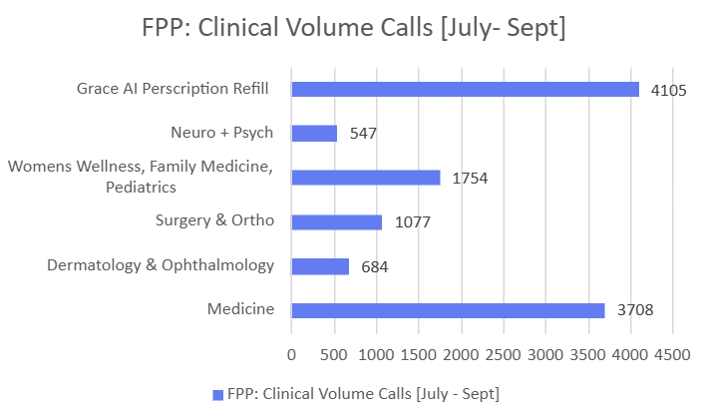
Improving Prescription Access + Patient Outcomes
FPP has a state-of-the-art Access Center – Powered by EGS Global AI Technology
Medication Access Gaps in Prince George’s County
Residents report difficulty affording prescriptions, even when insured.
Affordability gaps contribute to missed refills and lower adherence, worsening chronic disease outcomes.
FPP Solution: Patient Access Team
Our Patient Access Team currently manages on average 1000+ prescription refills per month efficiently.
With proven infrastructure, FPP can absorb demand in Prince George’s County and ensure patients have continuous access to needed medications.
Coupled with clinical teams, this reduces ER reliance and supports better chronic disease management.
*FPP Access Center became fully AI Integrated July 2025
Notes:
Patient Stories: https://www.princegeorgescountymd.gov/sites/default/files/media-document/2022%20Community%20Health%20Needs%20Assessment_Reduced.pdf?utm_source=chatgpt.com

Slide 21



Stories from Prince George's County Residents
FPP Intervention
Desired Outcome
Current State
C.F: Mother complained of chest pain. Waited 3 days without seeing a cardiologist; later found to have a heart attack and stroke.
S.D: An expectant mother in her final weeks of pregnancy was told no appointments were available until September, leaving her without needed follow-up care.
A.W: After surgery, Amy was discharged on a Friday but couldn’t access medications because the hospital pharmacy closed over the weekend.
Patient calls Clinical Access Line for chest pain; speaks with triage nurse and schedules a same-day cardiology appointment following ambulatory access guidelines.
Patient calls Access center, based on her diagnosis and progression due to pregnancy, priority culturally competent care is provided.
Patient calls medication refill line, supported by Grace AI. AI interface can refill prescriptions in real time and manage prescription care plans. Allowing Amy to pick up her medication within 24 hours at her nearest pharmacy.
Mother receives timely diagnosis and coordinated care, preventing a stroke or heart attack.
Mothers gain consistent prenatal follow-up, reduced anxiety, and safer deliveries through reliable access to care.
Patients like Amy leave the hospital with immediate or scheduled access to their prescription. Technology-enabled refill management ensures continuity of care, faster recovery, and fewer ER readmissions.
Notes:
Patient Stories: Phyllis Wright
https://www.fox5dc.com/news/prince-georges-county-takes-action-to-improve-excessive-er-wait-times?

Slide 22
Aligning with Prince George’s County Goals
1
Expands primary and specialty care capacity in areas with highest provider deficit
Reduces avoidable ER visits by shifting demand into community-based clinics
Provides culturally competent care from physicians who reflect and live in the community
2
3

Slide 23
FPP Care Model – Enhances Primary Care Access to Specialists in Prince George's County
Clinical Team Model: structured team-based care pairing each physician with nurses, PAs, medical assistants, and allied health staff for maximum efficiency
  We have implemented Nurse Care Coordinators in the following specialties to ensure patient access.
    GI/Endocrinology
    Women's Health
    Surgery
    Sickle Cell
    Cardiology
Improving Outcomes: ~5% higher diabetes protocol adherence, nearly double depression diagnoses through better screening, and fewer ED visits and hospital admissions compared to traditional models.
Source: (MGMA, 2020)
Notes:
Source: https://www.mgma.com/articles/advancing-to-team-based-care-in-the-ambulatory-enterprise?utm_source=chatgpt.com

Slide 24
FPP Care Model – Connects Prince George's County Residents to Centers of Excellence & Specialized Programs
Preventive and chronic disease management programs to reduce unnecessary ED utilization
  Faculty Practice Plan - #1 Vaccine Compliant Practice in D.C.
  Diabetes Treatment Center
  Heart Failure Bridge Clinic Pilot
  Sickle Cell Clinic
  Pediatric Disease Management
  Integrated behavioral health and substance use programs to reduce preventable hospitalizations

Slide 25
FPP Care Model – Creates Employment Pipeline for Prince George's County Residents
Proven workforce pipeline: medical students, residents, and apprentices trained and retained locally
Fortis Medical Assistant Apprentice Pipeline
  FPP has partnered with Fortis as a training site for medical assistants in training
  9 Fortis students have been hired on as full time staff following their training
Youth Apprenticeship Program
  FPP has received U.S Department of Labor Grant to train high school students to become healthcare apprentices. FPP and HUH has hired 25 apprentices thus far, FPP desires to bring this program to Prince George's County.

Slide 26
Faculty Practice Plan Partnership Commitment
Howard University Faculty Practice Plan understands the unique needs of Prince George’s County, as outlined in the Huron Report and Community Health Assessment.
We would like to partner with Prince George's County to address the healthcare concerns for its residents and expand Primary Care.

Slide 27
Thank You!

Slide 28
Appendix

Slide 29
Specialty & Integrated Care Services
FPP directly addresses specialty shortages identified in County assessment
Women’s Health & OB/GYN: maternal care, gynecology, high-risk pregnancy support
Surgical services: general surgery and orthopedics to alleviate procedural and pain care backlogs
Cardiology, Pulmonology, Oncology, Psychiatry: aligned with top gaps in County need projections
Integrated behavioral health and substance use programs to reduce preventable hospitalizations

Slide 30
High Burden of Chronic Disease and Maternal Health
~50% of adults are obese; obesity is most severe in the food-insecure Inner Beltway
Diabetes prevalence: 12% (~117,000 residents)
145,000 residents (~33%) are at risk for early-stage metabolic syndrome (diabetes, hypertension, hyperlipidemia)
Maternal health disparities:
Black women (18–44): 67.5% obesity risk
Hispanic women (18–44): 33% at risk for substance abuse
Cancer risk (colorectal, breast, lung, hematologic) is significantly elevated
Notes:
Source:
https://www.princegeorgescountymd.gov/sites/default/files/media-document/Prince%20George%27s%20County%20Healthcare%20and%20Social%20Needs%20Assessment%20%2B%20Investment%20Strategy%20Final%20Report-compressed.pdf

Slide 31



Access Barriers – Inequitable Distribution of Providers
Inner Beltway has no hospital and experiences the longest wait times
Inner Beltway and South County have 2–15x higher population-to-provider ratios than the rest of the County
Geographic inequities mean communities with the greatest need face the least access
Notes:
https://www.princegeorgescountymd.gov/sites/default/files/media-document/Prince%20George%27s%20County%20Healthcare%20and%20Social%20Needs%20Assessment%20%2B%20Investment%20Strategy%20Final%20Report-compressed.pdf

Slide 32
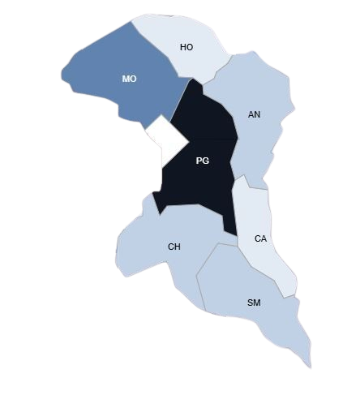
Prince George's County – Uninsured Patient Overview
Howard County: 4% Uninsured
Montgomery County: 8% Uninsured
Anne Arundel County: 5% Uninsured
Prince George's County: 11% Uninsured
Calvert County: 4% Uninsured
Charles County: 5% Uninsured
St. Mary's County: 5% Uninsured
Source: Prince George's County – County Health Rankings
​
Notes:
Source:
https://www.princegeorgescountymd.gov/sites/default/files/media-document/Prince%20George%27s%20County%20Healthcare%20and%20Social%20Needs%20Assessment%20%2B%20Investment%20Strategy%20Final%20Report-compressed.pdf

