Slide 2
What the “c” in cFTE really should mean
Presenters:
Jonathan K. Leer, MHA, MSA, FHFMA, FACMPE
Daffodil Baez, FACHE, MPH, MBA
Vincent Orange, Jr., MBA, MHSA
Presenters do not have any financial conflicts to report at this time.

Slide 3
Laying the Groundwork
Welcome to our discussion this morning! By the end of the session we will meet the following learning objectives together:
  Identify how cFTE can be viewed as a comprehensive rather than a finite terminology
  Discuss case examples to differentiate the common formulaic definition of time away from direct care
  Define and operationalize the new definition of cFTE to create lasting and productive change

Slide 4
Traditional Definition of cFTE
Clinical
  Often utilized in academic medicine, a setting with multiple missions
  Definition is not exclusive to that setting
  Let’s examine other areas where this term could be helpful
    Physician Practices with multiple locations (providers transitioning between offices)
    Practices associated with a major health system (clinically integrated networks)
    Practices with a teaching responsibility (ie residencies/fellowships)

Slide 5
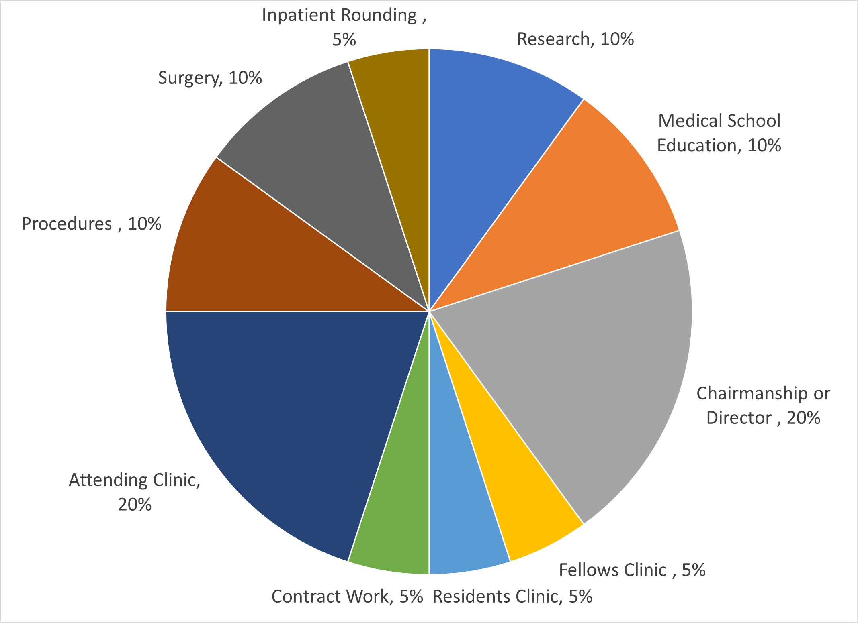
Traditional cFTE composition
Academic 40%
Medical Student Education
Clinical 60%
Attending Clinic
Fellows Clinic
Research
Chairmanship or Directorship
Procedures
Resident Clinic
Contracts
Surgery
Inpatient Rounding

Slide 6
But is that all? Could we mean more
It is our proposition that we could use the “c” in cFTE to mean so much more to an individual practice.
Let's Discuss several iterations

Slide 7
cFTE: Chaos FTE
Chaos can follow us in our daily lives in practice management and especially in those who have a financial duty each day.
What do we mean by Chaos:
  Day to Day FTE engagement that is misaligned with the mission of the organization, begins to offset cultural balance (Don’t throw off the “vibe”)
  Agents of Chaos: small issues that can become increasingly acute over time
  Case study review to see how Chaos is interwoven in daily practice management.

Slide 8
cFTE: Collaborative FTE
The next “c” is Collaborative
Collaborative FTEs are those who counterbalance the agents of Chaos and are engaged in our practice:
  Align with the mission of the organization, become an agent of "good"
  Caution: administrators can become too reliant on them. Utilize their gift of collaboration sparingly
  Potential for disenfranchisement in the practice to turn them into Chaos FTEs. Be vigilant of their well being.
Notes:
Just as Chaos can be an agent for destructiveness, our next “c” is Collaborative
They are often those that align with the mission of the organization and thus become an agent of "good"
While we are grateful for their engagement, we as administrators can become too reliant on them, and must utilize their gift of collaboration sparingly, and not always look to them
We must watch them as well, as it is possible for disenfranchisement in the practice to turn them into Chaos FTEs.

Slide 9

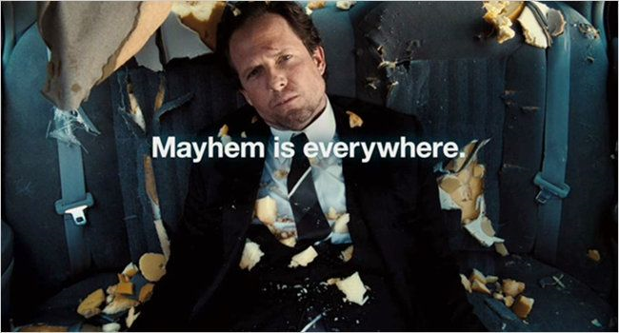
Case Study Interjection
OR

Slide 10
cFTE: Costly FTE
Provider recruitment is cost intensive, identifying the appropriate phenotype for your culture and clinical need is critical for longevity
A recent study of physician recruitment costs finds the below:
  From start to finish it takes 6-9 months to recruit most physicians regardless of subspecialty
  Inclusive of marketing, interviewing, outreach, and sign-on bonuses most practices will invest on average $250K into each hire
  Most practices report an average loss of $200K per month in revenues from an established physician when a position is vacated
We must retain our talent, or our costs will rise. How do we retain?!
Notes:
When we look at providers just as another “warm body” we can often overlook the cost associated with finding the right one, and thus the impact if we lose them within a year or two of hire
A recent study of physician recruitment costs finds the below:
From start to finish it takes 6-9 months to recruit most physicians regardless of subspecialty
Inclusive of marketing, interviewing, outreach, and sign-on bonuses most practices will sink on average $250K into each hire
Most practices report an average loss of $200K per month in revenues from an established physician when a position is vacated
We must retain our talent, or our costs will rise, but how do we retain?!

Slide 11
cFTE: Costly FTE (cont.)
Camouflaged requests
We wouldn’t dare?! Oh yes, we do……
  Examples:
    Credentialing committee at the hospital
    M&M committee
    Special committees (i.e. EMR, Audit oversight, etc.)
    Board of Directors/Partners meeting
We ask all of this without thinking, which leads us to………
Notes:
Well just as we looked at clinical FTE at our most basic of definition, we need to drop back to that point for something that can get away from us
How often do we as administrators ask for providers to participate in those items not related to direct patient care?

Slide 12
cFTE: Captive FTE
During the recruitment phase, whether you have a Chaos agent or a Collaborative agent, did you discuss with the candidate that there would be extra time after direct patient care?
Beyond a specialized hire (ie. CMO, CHIO, etc.) we often lead with amount of patients empaneled or potentially an amount of wRVUs to gain for the base salary (and likely bonus structure). What about all the other tasks?
A 2014 NIH study* found that almost 1/6th of a provider's time is spent on administrative tasks: charting in an EMR, on committees, or general tasks related to the practice.
We are often over-committing provider time, which could cost us
.
Notes:
*Woolhandler S, Himmelstein DU. Administrative work consumes one-sixth of U.S. physicians' working hours and lowers their career satisfaction. Int J Health Serv. 2014;44(4):635-42. doi: 10.2190/HS.44.4.a. PMID: 25626223

Slide 13

Case Study Interjection

Slide 14
cFTE: Corrective FTE
Now that we understand the pitfalls and how we could easily switch from one “c” to another, how do we quantify the issues and what could we stand to lose
Consequences:
  Reduced productivity
  Reduced engagement
  Lack of service continuity for your patient if you have to turn your practice over without a transition plan
  Reduced Provider Retention
What can we do?

Slide 15
cFTE: Clandestine FTE
Clinical Directorships and/or Chair Appointments, normally quantified as .20FTE, are mostly represented as the dreaded two-word phrase "admin time".
Physician leaders are faced with many clandestine (hidden) tasks and responsibilities whose commitment is more than a 4-hour session:
  Recruitment/dinners
  Lobbying
  Peer to peer mentorship
  Speaking engagements
  Student, Resident or Fellow development
  Vendor management
  Attending evaluations
  Grading or clerkship management
  Policy Interpretation

Slide 16
cFTE: Consequential FTE
While we define the chaos FTE as temporary state, the consequential cFTE has long term effects, resulting in physician burnout, undesirable culture, and internal erosion of practice that is only visible to the outside looking in
Consequences arise when we don’t properly manage the other C's
The cause can be simple but the effects are damaging
  Hiring a physician before building infrastructure
  Changes in compensation and incentive models that don't match a specialty
  Denying an FTE that a practice desperately needs
  Not knowing your market share and value proposition to patients
  Business plans that aren't aligned with the culture of your org or have stakeholder support
  When the SOM, Corporate Parent and Hospital are "frenemies"

Slide 17

Case Study Interjection

Slide 18
cFTE: Comprehensive FTE
Looking at the fullest picture of what it means to hire and retain top talent. Can not only be the best for your patients, but also to your bottom line.
Recent publications have found that private practices are not equipped to handle a transition of management with NextGen graduates. The Parachute will collapse!
Analyze the comprehensive view of an FTE before we bring someone into the practice. Be honest about their day to day with reasonable expectations through constant communication.
Let’s go to our case study one last time…….
Notes:
Describe the parachute of current senior talent holding up practice structure

Slide 19

Case Study Interjection

Slide 20
Which “C” are you?
Notes:
Only one question remains...

